Slide 1
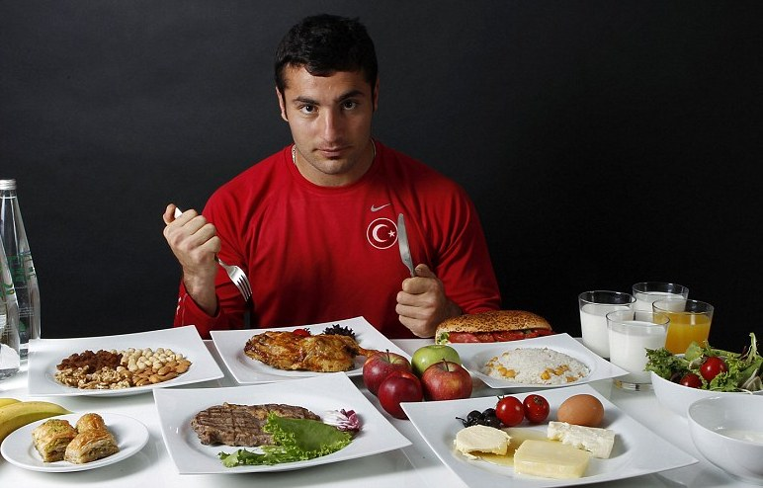
NUTRITION AND ATHLETIC PERFORMANCE

Slide 2
BASIC PRINCIPLES OF HEALTHY EATING
Regular meals & snacks
No skipping meals!
3 meals plus snacks (eating every 3-4 hours)
Eat from all 4 food groups
Variety
Balance
Mindful eating/appetite awareness (listen to your body)
Include treats in moderation

Slide 3
MACRO AND MICRO NUTRIENTS
Macronutrients-provide energy (Calories)
Carbohydrates
Proteins
Fats
MICRONUTRIENTS
Vitamins
Minerals

Slide 4
MICRO-NUTRIENTS
Some are especially important for teens and athletes…
Iron
Carries oxygen through the body
Sources include meat, poultry, fish, whole grains, nuts, seeds, soy, eggs
Vitamin C (citrus, strawberries, kiwi, green/red bell pepper, broccoli, etc.) helps with absorption of iron
Coffee, tea and calcium interfere with iron absorption
B VITAMINS
Help release energy in the body (metabolism)
Help build & repair tissues and blood cells
Eating foods from all 4 food groups & getting enough calories will ensure that you meet your needs
Vitamin B-12 is only found in foods of animal origin (meat, eggs, dairy)

Slide 5
MICRO-NUTRIENTS
Calcium
Important for healthy bones and teeth
Up to age 19 years, you need 1300mg/day
250ml milk or fortified alternative beverage, ¾ cup yogurt or 50g (1.5oz) cheese all provide 300mg
Various other foods provide small amounts
Vitamin D
Helps your body absorb calcium & keeps your immune system strong
Limited sources…Fortified milk & alternative beverages, fortified margarine, egg yolks & fatty fish such as salmon, mackerel & tuna

Slide 6
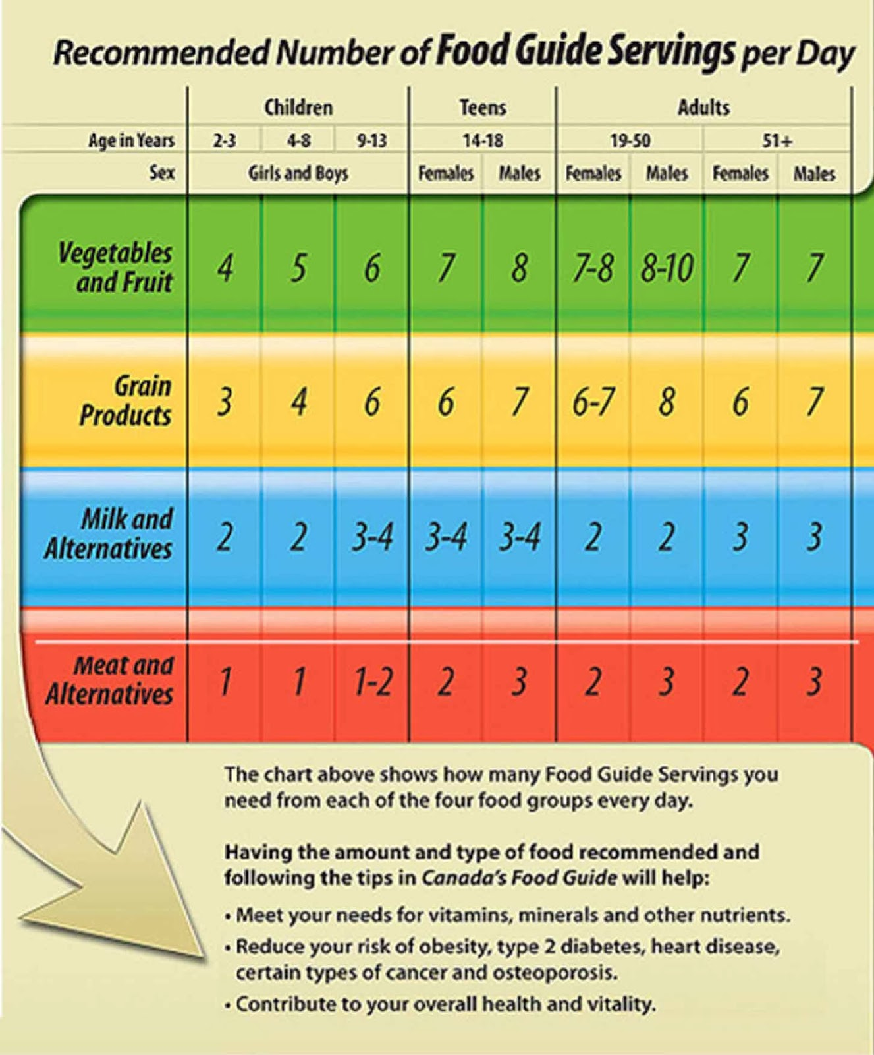
CANADA’S FOOD GUIDE
One of many tools to teach nutrition & guide our choices

Slide 7
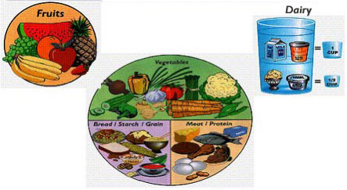
KEEP IT BALANCED
Another tool is the ¼ Plate Method of Meal Planning

Slide 8
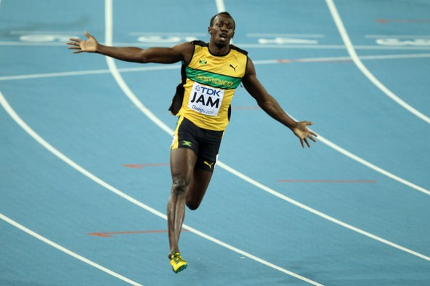
SPORTS NUTRITION
Energy requirements depend on
Gender
Height
Weight
Activity level
There are formulas used to estimate daily calorie needs but these only provide and estimate
Your energy needs are being met if you are maintaining a healthy body weight

Slide 9
PROTEIN REQUIREMENTS
Protein is needed to build & repair muscle & is used for energy
Daily need is based on body weight
General population 0.8-1.0g protein/kg
Endurance athletes 1.2-1.4g protein/kg body weight
Strength athletes 1.2-1.7g protein/kg body weight
Example: 165 pound athlete
165lbs ÷ 2.2 =75kg
75kg x1.4g protein/kg=105gprotein/day
Also looked at as a percentage of daily calories
RDA is 10-30% of daily calories from protein

Slide 10
PROTEIN SOURCES
Meat, poultry, fish or shellfish
Beans, peas
1 egg
Cheese, cottage cheese, nuts, seeds, hummus, milk
Yogurt, greek yogurt

Slide 12
CARBOHYDRATE REQUIREMENTS
Carbs provide energy for muscles & brain, especially during physical activity
High carb diets are associated with:
Greater endurance, faster time trial performances, lower rates of perceived exertion
Daily need is based on body weight: 6-10g/kg of body weight
Also looked at as a % of daily calories 45-65%
Example:165lb (75kg) athlete
75kg x 6g = 450 g carb/day

Slide 13
CARBOHYDRATE SOURCES
1 slice of bread, ½ cup rice, pasta, ½ cup corn or mashed potato
½ a potato, 3 cups popcorn, ¼ large bagel
½ hamburger or hotdog bun, 1 cup milk
1 piece of fruit, 1 cup blueberries, 2 cups strawberries, ¼ cup dried fruit, ½ cup juice

Slide 15
FAT REQUIREMENTS
Fat is essential in the diet for both health & athletic performance
Fats provide energy
The brain is nearly 60% fat
Fats are a component of hormones & cell membranes
Percentage of daily calories: 25-35%
Don’t need to pay special attention to daily fat intake
Instead, eat from all food groups, include added fats & eat enough to maintain a healthy weight

Slide 16
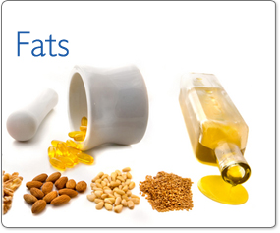
FAT SOURCES
Meat, eggs, nuts, seeds, peanut & almond butter, soy products, milk (except skim), yogurt, cheese
Added fats such as butter, margarine, oil, salad dressing, mayonnaise, sour cream, etc.

Slide 17
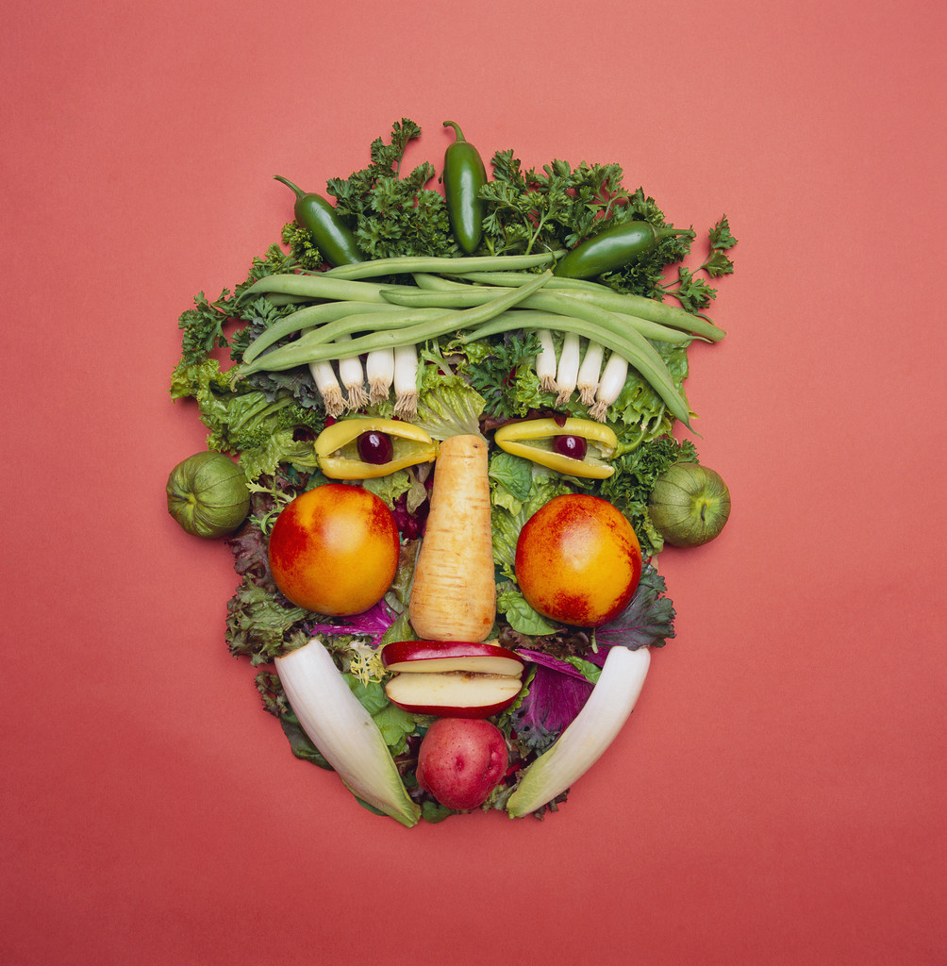
SAMPLE MEAL PLAN
BREAKFAST: 2 slices toast with peanut butter 250ml 1%milk, 1 banana
LUNCH: wrap with turkey, cheese, lettuce, tomato,
Ranch, 1 apple, 1 juice box
SNACK: 100g yogurt, ½ cup berries, 1/3 cup granola
DINNER:1 cup pasta with alfredo sauce, 6oz chicken ,
1/2cup broccoli, 1 cup salad with dressing,
250ml milk
SNACK: 250ml milk & 2 cookies

Slide 18
WHAT TO EAT BEFORE EXERCISE
Size & timing of a meal or snack before exercise depends on individual needs and tolerance
2-4 hours before exercise: drink plenty of fluids, eat a meal rich in carbs & relatively low in fat, protein & fibre
The goal is to provide energy without leaving an excess of food in the stomach, which may cause gastrointestinal distress
Some people experience stomach upset if they eat too close to exercise-fluids such a s smoothies or sports drinks are a good option in this case
A pre-competition meal should always be tried in training before competition

Slide 19
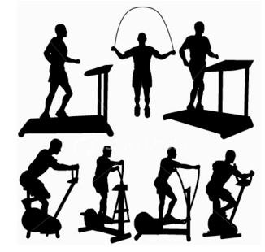
WHAT TO EAT BEFORE EXERCISE
Meal/snack ideas:
Cereal with milk ( avoid very high fibre types)
Fruit & yogurt
Bread or bagel
Pasta
Oatmeal with a banana & milk
Granola or sports bars
Smoothie with milk/yogurt & fruit

Slide 20
CARBOHYDRATE LOADING
Done for competitive, intense activities that last longer than 90 minutes
This builds extra carbohydrate energy stores (glycogen) in muscles & the liver
Involves intake of 8-11g carb/kg body weight combined with tapering from exercise for 1-3 days before competition
May not offer any benefit to athletes who:
Regularly consume a moderate to high carb diet
Consume a carbohydrate-rich meal or snack pre-competition and consume carbs during the exercise

Slide 21
WHAT TO EAT DURING EXERCISE
Endurance Exercise:
Eat carbs & fluids during intense exercise that lasts longer that 1 hour
Carbs will extend time to exhaustion & improve performance
Consume 30-70g carb/hour in small amounts, every 15-20 minutes
Start shortly after exercise begins
Should include different sources of carbs
Sports drinks or gels are common & convenient

Slide 22
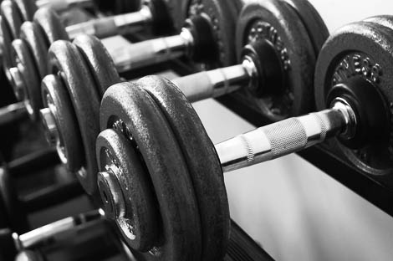
WHAT TO EAT DURING EXERCISE
WEIGHT TRAINING
Eat protein during resistance exercise appears to result in:
Less muscle protein breakdown & greater muscle protein synthesis during or immediately after exercise
Greater gains in body mass & muscle strength in long-term training

Slide 23
WHAT TO EAT AFTER EXERCISE
Need carbs to replenish glycogen stores, protein to repair muscle and fluid to rehydrate
Carbohydrates
Consume 1-1.5g carb/kg body weight during the first 30 minutes after exercise & again every 2 hours for 4-6 hours Approx. 75-112g of carb
This is especially important for athletes who compete, train or exercise more than once a day or who do not have a full day to recover
Protein
Consume 10-20g of high quality protein (dairy, eggs, meat) in the early recovery period

Slide 24
HYDRATION
Stay well hydrated by drinking before, during & after exercise to replace sweat losses
The amount and color of your urine is a good indicator of your hydration status
Larger signs of pale yellow urine is a sign you are well hydrated
A small amount of dark yellow urine indicated dehydration

Slide 25
SPORTS DRINKS
Sports drinks provide:
Fluids to cool the body down & replace fluids lost in sweat
Carbs for quick energy
Sodium & potassium (electrolytes) to replace minerals lost in sweat
Drink Sports drinks when:
The exercise in intense, the activity lasts longer than 1 hour, you sweat a lot, you wear protective equipment, the weather is hot & humid, your fluid needs to be quickly replaced ( during a tournament etc.)

Slide 26
CHOOSING A SPORTS DRINK
What to look for in a sports drink
No carbonation
Carb content: 30-60g/litre,
Sodium 460-690mg/litre or at least 70mg/250ml
Potassium: 78-195mg/litre

Slide 27
SPORTS SUPPLEMENTS
Many performance enhancing agents are banned ( refer to the Canadian Centre for Ethics in Sport)
Nutritional supplements are considered “natural health products” & are given a “natural product number” (NPN)
As opposed to medications which are given a “drug identification number” (DIN)
NPN’S & DIN’S are regulated by Health Canada but with different standards & procedures
NHP’s include: vitamins, minerals, herbal remedies, homeopathic medicines, probiotics

Slide 28
NUTRITIONAL SUPPLEMENTS
Concerns with these products include lack of testing & contamination with dangerous or banned substances
Common Supplements
Caffeine: a stimulant which may help increase energy & improve endurance & reaction time
Moderate amounts of caffeine (3mg/kg body weight) can have performance benefits
Urinary thresholds set in IOC and National Collegiate Athletic Association
Too much caffeine can result in anxiety, nervousness, increased heart rate, insomnia and stomach upset

Slide 29
NUTRITIONAL SUPPLEMENTS
Energy Drinks: not recommended, various ingredients include caffeine, taurine, B-vitamins, antioxidants herbals such as ginseng etc
Adverse effects include dehydration, high blood pressure, arrhythmias, seizures, mood changes
Protein powder: many athletes do not really need it but may be beneficial for some (high protein needs, food preferences, convenience)
Check ingredients list to be sure it is not contaminated with other supplements (no palm kernnal oil in protein bars, clogs arteries)
1 scoop of protein powder usually = 25g of protein

Slide 30
NUTRITIONAL SUPPLEMENTS
Creatine: increases energy through adenosine triphosphate (ATP) production in muscle, enhances performance in short-duration, high intensity exercise, long-term benefits & risks are not well studied
Glucocorticoids: Alter glucose metabolism & have anti-inflammatory & pain-relieving properties, usually prohibited in competition, use & efficacy is not well documented, short-term use may cause high blood sugars, fluid retention, & mood changes: long-term side effects are worse

