Slide 1
BODY IMAGE

Slide 2
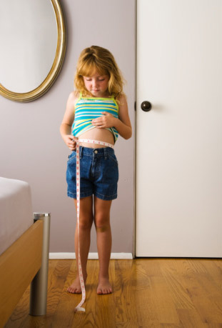
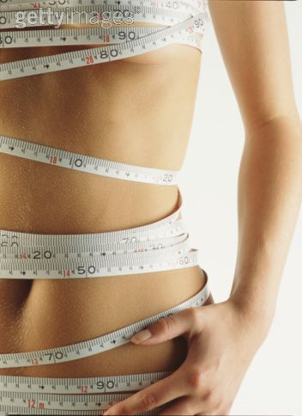
BODY IMAGE: the mental picture a person has of his/her
own physical appearance and the associated attitudes and
feelings toward their own body and how they think others
see their body
Adolescents are acutely aware of their appearance and
intensely sensitive to how they are perceived and accepted
by others

Slide 3
SELF-ESTEEM: reflects a person’s overall evaluation of
his or her own self worth
Self-esteem is very important with regard to general
motivation, learning capacity, & self-acceptance
Developing a positive body-image and aiming for a healthy lifestyle will help enhance self-esteem
Body image & self-esteem are constantly changing

Slide 4
HOW DOES THE AVERAGE WOMAN MEASURE UP?
5/10 adolescent girls and women struggle with eating disorders and borderline conditions
1 million boys and men struggle with eating disorders and borderline conditions
Almost half of elementary school students between the first and third grades want to be thinner
4 out of 5 children at the age of 10 are afraid of being fat
Half of 9 and 10 year old girls feel better about themselves If they are on a diet
1 in 5 eleven year olds are on a diet

Slide 5
Most fashion models are thinner than98% of women
8% of women have an hourglass body type
a psychological study found in 1995 that 3 minutes spent
looking at fashion magazines caused 70% of women to feel
depressed, guilty & ashamed
Frequent readers of women's magazines were more likely
to have Dieted or exercised to lose weight

Slide 6
Males are at a higher risk of developing eating disorders if
they participate in sports with a weight restriction
The models in magazines are airbrushed, clipped, and touched up
1 in 4 college-aged women has an eating disorder
Society’s image of a “perfect women” changes over time
Marilyn Monroe wore a size 12… compared with today’s models she would be considered overweight

Slide 7
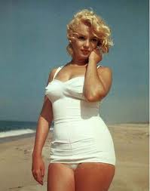

Slide 8
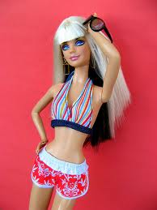
AVERAGE WOMEN’S PROPORTIONS VS. BARBIE’S PROPORTIONS
HEIGHT 5’4 6’
WEIGHT 145LBS 101LBS
DRESS SIZE 14 4
BUST SIZE 36 39
WAIST SIZE 39 19
HIP SIZE 42 33
If Barbie were a real women she wouldn’t be able to stand up! She’d have to walk on all fours!

Slide 9
FACTORS AFFECTING BODY IMAGE
MEDIA
Soap operas, billboards, advertisements, movies, TV, music
Videos, magazines, beauty contests, fashion shows etc.
FAMILY
- their eating habits, body image, activity patterns, attitudes
towards food, comments on appearance etc.
FRIENDS
Peers reinforce each other’s beliefs about the ideal body,
teens feel a need to conform

Slide 10
SOCIETY
Perfect industry, pre-programmed to expect a “quick fix,
self-worth is based on physical characteristics
SELF-ESTEEM
Develops from birth & continues to be shaped by significant
people in their life, personal characteristics add to feelings of
self-esteem
HEALTH PROFESSIONALS
Annual physical (height/weight), cosmetic surgeons
advertising the perfect body

Slide 11
GUIDELINES FOR BUILDING A BETTER BODY IMAGE
Accept that healthy people come in all shapes and sizes.
Do not compare yourself to others. You are a unique person who has inherited a body that is suited for you.
Define beauty for yourself. Do not let media or others tell you what to think about your body.
What the media portrays doesn’t reflect reality; there is no such thing as a ”perfect body”
Look in the mirror and notice what you like about your body.
Begin to appreciate your body and what it can do by engaging it in such activities as stretching, dancing, etc.

Slide 12
Be aware of messages your body gives to you and respond to them appropriately. E.g. tired= rest, full=stop eating
Remember there is more to you that just your weight or your body size & shape
Live in the present. I you are always waiting to get thin before you do this or that, then you will spend most of your life waiting and not doing or being.
Learn to nurture yourself with things other than food. E.g. relax with music
Leave the scales to the fish! Do not allow numbers to determine how you feel about yourself.
Wear clothes that you find attractive & comfortable. Wearing uncomfortable clothes may cause you to be dissatisfied with your body.

Slide 13
ENERGY REQUIREMENTS FOR DIFFERENT STAGES OF LIFE
INFANTS – at the highest growth curve, require a higher fat diet, foods that are easily digested
CHILDREN – high growth curve & are very active, therefore require a higher fat diet, as well as grain products to continue a healthy growth pattern
YOUTH- during puberty, high growth spurt, therefore require sufficient energy to meet the physiological needs, nearing adulthood & therefore need to begin to eat lower-fat foods in order to be ready for the end of their growth curve
ADULT- need to consume more vegetables & fruit, low-fat foods, need to lead an active lifestyle in order to maintain a healthy weight and decrease health risks

Slide 14
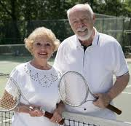
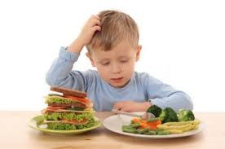
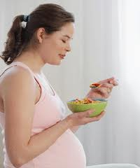
PREGNANT/BREASTFEEDING- must consume nutrient-dense foods & additional milk products
OLDER ADULT- metabolism is slowing down, need to consume less food, food choices must be nutrient dense, maintain an active lifestyle

Slide 15
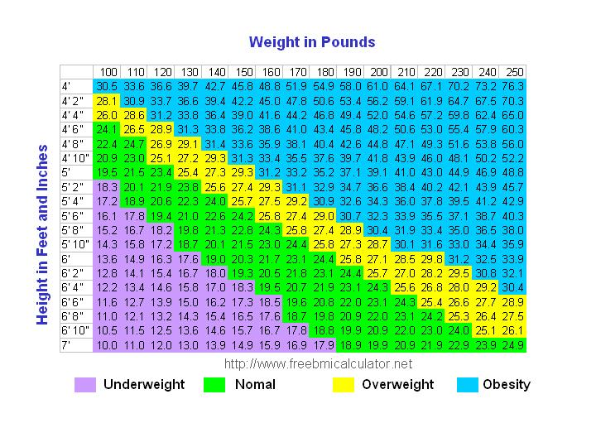

Slide 16
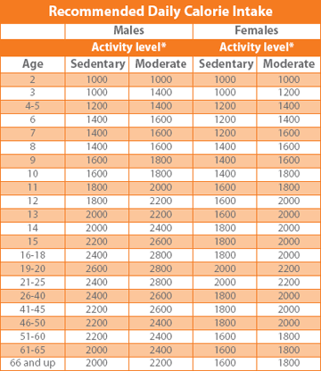

Slide 17
HEALTH RISKS ASSOCIATED WITH OBESITY
High blood pressure
Diabetes
Heart disease
Cancer
Mental health issues
Risk of using dangerous weight loss methods
Risk of developing eating disorders
Arthritis
RISKS ASSOCIATED WITH BEING UNDERWEIGHT
Heart irregularities
Depression/emotional distress
Anemia
Risk of developing extreme eating disorders

Slide 18
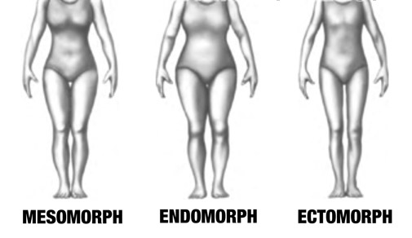
Genetically Predetermined Body Types
ENDOMORPH - soft, round appearance, high percentage of body fat, average to
Large body frame, legs may appear short compared to total body size
MESOMORPH- firm, well developed muscles, average to large bones, broad
Shoulders, slim waist, powerful legs, well-proportioned limbs
ECTOMORPH- small bones, slender, angular, with little muscle or fat mass,
narrow chest and shoulders, arms & legs appear longer in proportion to torso

Slide 19
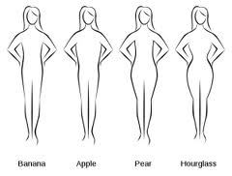

Slide 20
SET POINT THEORY
States that each body has a particular weight that it tends to maintain
Genetics plays a key role in determining body weight and shape
Set point can fluctuate between 5 & 10 pounds and cannot be lowered through restrictive dieting
If an individuals weight is below or above their set point weight range, their body will experience physiological and emotional changes in an attempt to re-establish itself

Slide 21
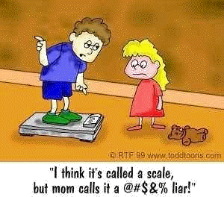
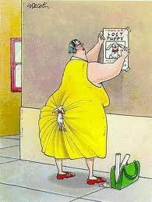
As less food is eaten, a person’s basal metabolic rate decreases (the rate at which calories are used by the body) decreases. Food eaten is then used more efficiently in an attempt by the body to defend its set point and to prevent further weight loss
There is no ideal weight for those of the same height & age because people have different body shapes and frames

Slide 22
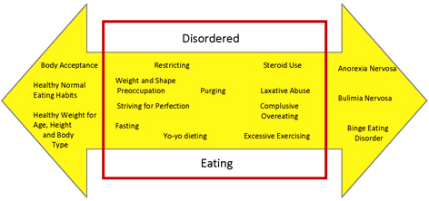
EATING DISORDER CONTINUUM

Slide 23
TUNING INTO HUNGER
A non-dieting approach to eating involves eating when you are hungry and stopping
when you are full. There are several degrees of hunger ranging from feeling full
to feeling extremely hunger.
0=SATISIFIED – not hungry, no thoughts of food, may have had a meal recently
1=THINKING OF FOOD – vague thoughts of food, not ready for a meal, may eat for
something to do if upset or bored
2=HUNGRY – hungry enough to eat a meal, temporarily satisfied with a snack,
making decisions about what to eat
3=REALLY HUNGRY – thinking of food a lot, irritable, stomach growling, low energy
nausea, upset stomach, getting harder to concentrate
4=STARVING – feeling shaky, decreased physical co-ordination, experiencing a
headache, unable to concentrate, may feel sleepy, may faint

Slide 24
THE THREE D’S
DIETING
33 billions dollars are spent on dieting & diet related products each year
The diet industry’s target consumer is the “professional female dieter”
The risk of Yo-Yo dieting far outweigh the benefits
Genetics plays a key role in determining shape, weight and size etc.
50% of females between the ages of 11 and 13 already se themselves as
overweight
Individuals who diet are 8% more likely to develop an eating disorder
BODY DISSATISFACTION
80% of adult women are dissatisfied with their bodies
According to one study, up to 13% of 9 year olds reported a fear of being fat,
and by the age of 11, 51% began their first diet
Many dieting teenagers experience the passage through puberty with repulsion
and disgust

Slide 25
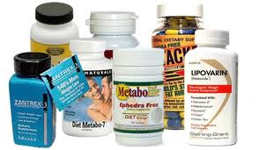
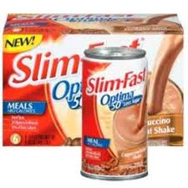
DRIVE FOR THINNESS
Since the mid-sixties, we have become a nation obsessed with thinness
This obsession is perpetuated by the myths that thinness equals beauty,
perfectionism
Happiness, self-confidence and self-control
Drive for thinness is often passed on by mothers to daughters through a
process of learning and imitation
Also responsible are the diet, beauty, and fashion industries, which bombard
us with mixed messages through media advertising
REMEMBER
“It’s not your bodies that need changing, it’s our attitudes.”

Slide 26
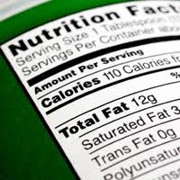
WHAT REALLY HAPPENS WHEN WE DIET, “JUST FOR GIRLS”
HOW WE DIET-THIS IS WHAT REALLY HAPPENS
Skipping meals or decreasing calories
This lowers metabolism so we store fat more easily from fewer
calories
The brain & muscle’s demand for fuel causes rebound munchies,
usually for high fat & high sugar items
Poor attention span, irritability, fatigue
Muscle tissue may be lost
Cut out starchy foods
Your body loses its best source of stable energy
You’ll be more likely to fell moody & tired
You’ll end up eating higher fat & sugary foods to satisfy munchies

Slide 27
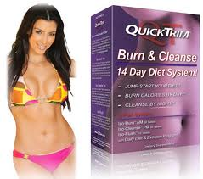
Go on a Preplanned Meal Replacement Diet or Liquid Diet
You have 95% chance of regaining any weight you lose in 1 to 2 years
You give away control to the plan which lowers your self-esteem
You often lose muscle mass along with fat. This lowers your metabolism,
making it easier to store fat on fewer calories
Habits are replaced temporarily, not changed permanently
They are expensive!
Cut out Meats Without a Comparable Replacement
May risk iron deficiency which leads to fatigue
Energy from meals may not last as long, causing more hunger in between
Meals for high fat, high sugar foods

Slide 28
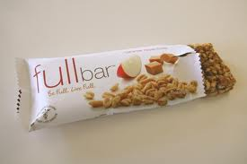
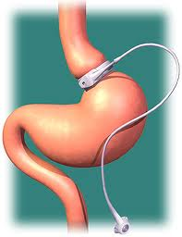
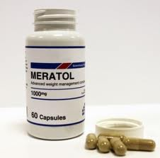
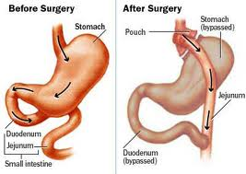
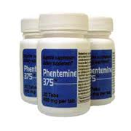
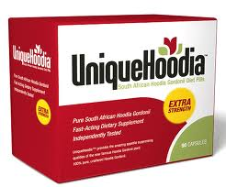
DIET PRODUCTS
The diet industry makes billions of dollars every year. Each year new weight loss
products and gimmicks are introduced.

Slide 29
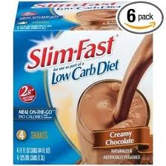
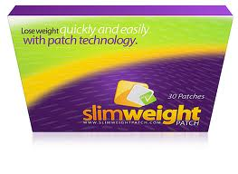
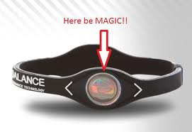
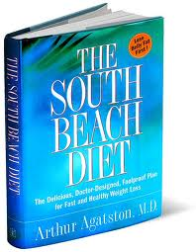
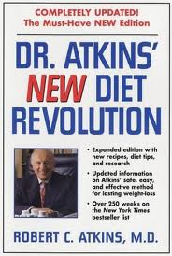

Slide 30
Fasting
Most of the weight lost is water
Muscle mass decreases which lowers metabolism, and therefore causes fat gain
Can be medically dangerous
WHY WE DIET
To Be Slim
Over the long run, 95% of dieters regain the weight, most gain back more weight, so they diet again with similar poor results
This is called the Diet Cycling/Yo-Yo Dieting and often leads to obesity, it also increases health risks

Slide 31
There is no evidence that being plump is unhealthy, but there is evidence that
shows being too thin is unhealthy
Most diets decrease out muscle mass, muscle is needed for a healthy lifestyle
and a healthy metabolism
TO BE HEALTHIER
Many diets are unhealthy, your body and mind don’t run well when you restrict calories
Dieting makes you moody & irritable and obsessed with food, this feels like failure,
but in fact it is a physiological response and has nothing to do with willpower
TO BE MORE ATTRACTIVE
What attracts you to someone else? What are long-term relationships based upon?
If you are dieting are you any fun to be around?

Slide 32
MYTHS AND MISCONCEPTIONS
Being thin will make me popular
Thin people are happy
Being thin will make him love me more
Thin people are successful
Thin people have self-control & will power
Thin people are hard workers, smart & powerful
Fat people are unhealthy
Dieting will help me achieve the “ideal body”
Skipping meals will help me lose weight faster
Fat people are lazy, sloppy and stupid

Slide 33
SUGGESTIONS FOR DEVELOPING A HEALTHY, NON-DIETING, ACTIVE LIFESTYLE
Become aware of your body signals for hunger & fullness
Eat until you feel full or satisfied. You don’t have to eat everything on your plate
Make time to eat meals & snacks, including breakfast
Make eating a sit down activity as often as possible
Try to avoid the unconscious eating that may take place in front of the TV, at the
movies, talking on the phone/on the computer etc.
Try foods from all the recommended food groups
Avoid using bathroom scales
Allow time to relax
Get enough sleep
Make gradual changes in your lifestyle

Slide 34
ANOREXIA NERVOSA
An emotional disorder characterized by an intense fear of fat that results in
Extreme dieting
The loss of at least 15% of normal body weight or a failure to reach within
15% of normally expected body weight
Affects mostly women between the ages of 12-24
Low self-esteem, a distorted body image, obsession with food are common
Relentless pursuit of thinness
results in death in 10-15% with the disorder

Slide 35
SIGNS
Noticeable weight loss in a short period of time ( approx. 3 months)
Become a pickier eater, avoiding certain food groups etc.
Obsession with food, recipes, hours of exercise
Individual denies being hungry even though they are starving
Hunger may not be recognized due to the large water intake
Feel a false sense of control when they resist the urge to eat
Feel out of control in other areas of their life
Perfectionism and unrealistic expectations for personal achievement
May binge due to prolonged starvation, often purge whatever is consumed to avoid weight gain

Slide 36
EFFECTS
Chronic constipation, alternating with diarrhea, dry pasty skin, depression
Irritability, and distorted body image
Lack of adequate body fat= always feeling cold
Fine downy hair may grow on parts of the body
Menstruation stops
In males there is a decrease in sex drive
Internal organs are weakened, the body begins to shut down to
conserve energy
Individuals may continue to perform day to day activities with bursts of energy
Eventually they will have faintness, weakness, irregular heartbeats and may
Pass out due to extreme exhaustion & fatigue

Slide 37
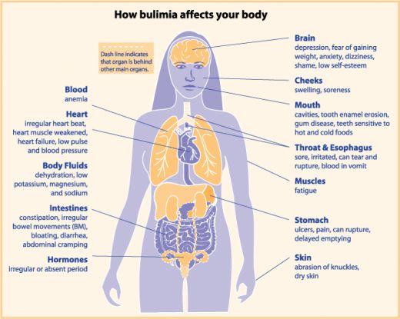

Slide 38
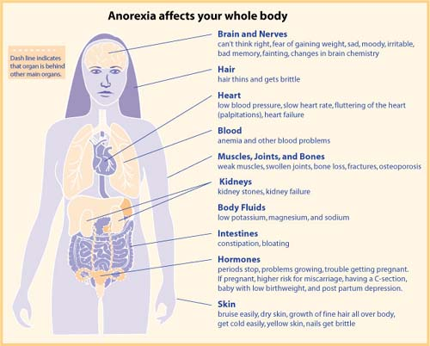

Slide 39
BULIMIA NERVOSA
Emotional disorder, characterized by binge eating & a method of purge at least
2 days/week for a period of 3 months
The person eats to control overpowering emotions & are often not hungry at this
point
Purging= vomiting, laxative, diet pills, over exercising, diuretics & or fasting
More than one method of purging is often used
Usually within 10lbs of normal weight
Affects 15-20% of college women
Males & females are both affected
Often starts out as a simple diet, escalating into a binge/purge cycle, that feels
very much like an addiction

Slide 40
SIGNS
Weight fluctuations, soreness in the mouth, gums, teeth are sensitive to cold & hot
Swollen glands in the neck, chronic sore throat, fainting spells, dizziness, frequent trips to the bathroom after eating
Secretive about eating
EFFECTS
Chronic constipation,, broken blood vessels in the eyes, and bags under the eyes
Depression, irregular heartbeats, electrolyte imbalance
Stomach muscles may stretch due to the large amounts of food ingested
Tears in the esophogus, & if it ruptures it can cause instant death
CHARATERISTICS
Purging is a coping mechanism used to control overwhelming emotions
Often a history of sexual abuse
Food has a special meaning: comfort, punishment, reward, anger, control

Slide 41
TREATMENT FOR ANOREXIA & BULIMIA
Medical attention to monitor health
Medication is often used to help depression
Counselling, therapy, support groups
Nutritional education
Windsor/Essex County – BANA, Teen Health Centre, Family Dr.

Slide 42
DEFINITIONS
RESTRICTIVE EATING - a futile, often harmful process of restrictive eating usually
caused by body dissatisfaction, preoccupation with thinness, and the false
belief that self-worth is dependent upon body and size
DYSFUNCTIONAL EATING - troublesome eating behaviours, such as restrictive
dieting, bingeing, or purging, which occur less frequently or less severely than
those required to meet the full criteria for the diagnosis of an eating disorder
OVER-EXERCISING - exercising compulsively for long periods of time as a way to
Burn calories from food that has just been eaten
PURGING - attempts to rid the body of food consumed by engaging in self-induced
Vomiting, use of laxatives, enemas, diuretics and excessive exercise, skipping
Meals or dieting
STEROIDS – there are 2 types of synthetic steroids: anabolic and androgenic
Anabolic- tissue building Androgenic – masculinizing effect, even if the user is
female

